Slide 1

AIR
Autonomous Interdependent Repositories
by Artem Shamsutdinov

Slide 2
Federated Multi-Repository Database
Any # of users, web sites/Apps.
Any # of schemas for any # publishers
Data access w/o network connection
Access to only allowed data
Data confidentiality and authenticity
Redundant storage and archival
Switchable sharing channels
“eventually consistent”
“time traveling”

Slide 3
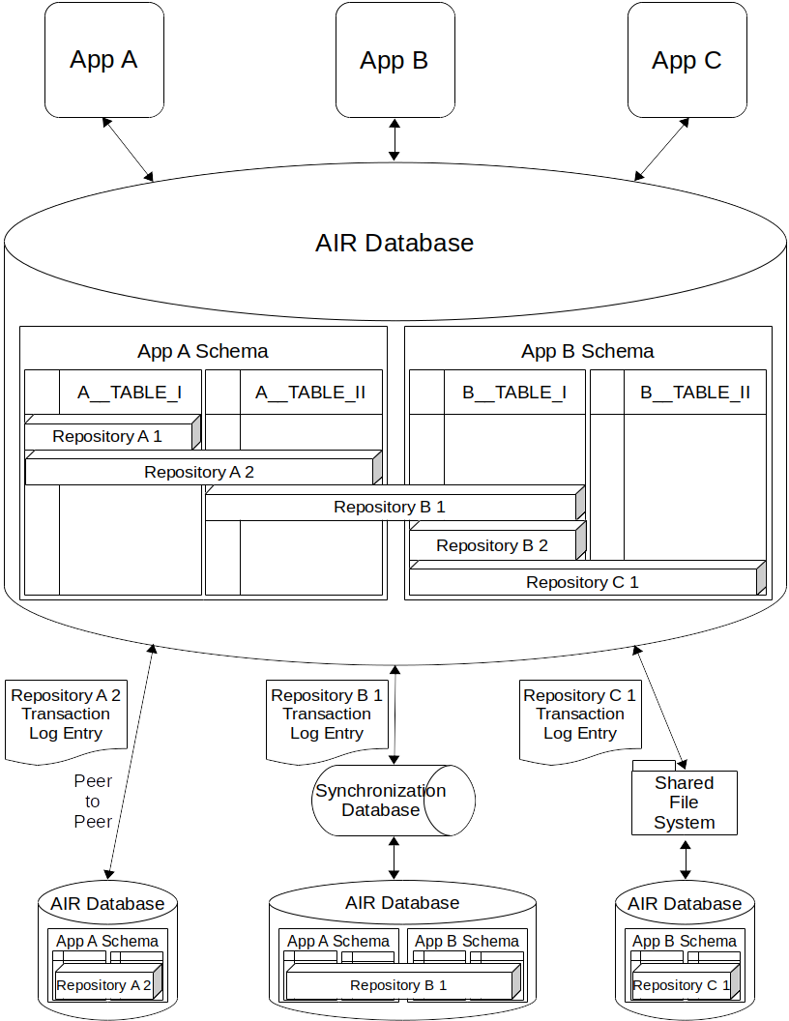

Slide 4
Repositories
Logically - virtual collection of related records
Physically - collection of rows across any number of tables
Stored in fully functional relational database
Database stores any number of repositories
Repositories are archived away and are retrieved back

Slide 5
Synergy across Apps
Multiple websites and mobile Applications access the same data
Schemas open to other Applications
Other Apps enrich functionality of original Application in new ways
User gains more value from already entered data
Publisher monitors what Applications are using their schema
Compound benefit of data accumulated across many Apps
New AIR Application immediately gain access existing data

Slide 6
Transaction Log
Changes to Repository recorded in its Transaction Log
Ordered by time of synchronization
Shared across databases
Repository state may differ across Databases
State is “eventually consistent”
Repository archive = all Transaction Log entries, ordered
Archived Repository load = execution of all entries, in order

Slide 7
Schemas
Apps provide schemas
Schemas distributed directly or via publishing platform
Apps store records in own or other schemas
Apps may allow other Apps to do CRUD
Applications grand/revote access at any time
Grants to App, Table, Column or User / per Operation
Grant groupings possible
Dedicated grant repositories distributed by Apps

